Slide 1
02: Builtin Functions & Definitions
MercedEnergy.com
12-06-2018

Slide 2
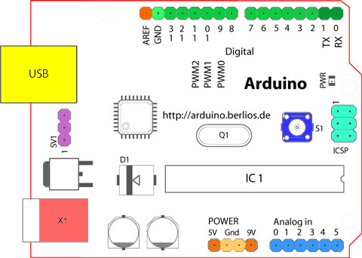
Arduino
Digital Pins
Analog Pins
Power Pins
GND
Board
https://www.arduino.cc/en/Guide/Board?from=Tutorial.ArduinoBoard

Slide 3
Definitions
LED - Light Emitting Diode
Anode (+) : Longer leg
Cathode (-) : Shorter leg
MCU - Microcontroller Unit
Atmega328P
Prototyping : Early Concept, built to test a concept.
Breadboard : Making temporary circuits, for prototyping.
Resistor : Limits amount of current.

Slide 4
Programming
Arduino programming language : Based on C/C++
Variables
LED_BUILTIN
Predefined LED pin number.
HIGH
Voltage of 5V
LOW
Voltage of 0V

Slide 5
Functions
Built In Functions
delay()
Stops code execution. Blocking functions
millis()
Internal time. Returns in milliseconds.
setup()
Runs once, initializes variables, libraries, pins.
loop()
Executes continuously.

Slide 6
Thank You
Ramiro Gonzalez
209-962-2524
ramirogonzalez@mercedenergy.com

Slide 7
Sources
https://en.wikipedia.org/wiki/Prototype
https://internetofthingsagenda.techtarget.com/definition/microcontroller
Amariei, Cornel. Arduino Development Cookbook. Packt Publishing, 2015.

